Slide 1
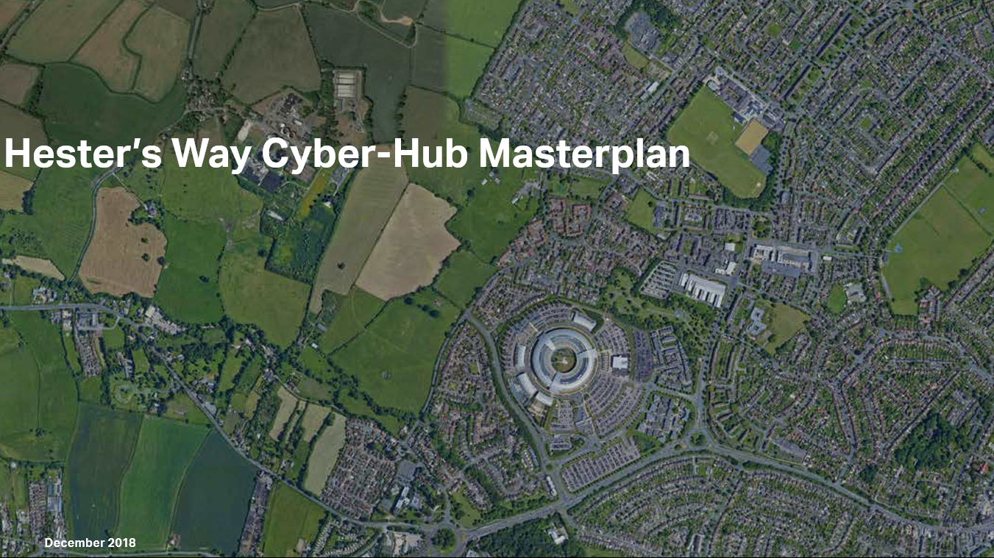
CYBER CENTRAL
HESTERS WAY NEIGHBOURHOOD PLAN

Slide 2
Planning Policy Framework
Gloucester, Cheltenham and Tewkesbury Joint Core Strategy (2021?)
Cheltenham Plan (2019?)
Neighbourhood Plans
Hesters Way
Leckhampton
Springbank

Slide 3
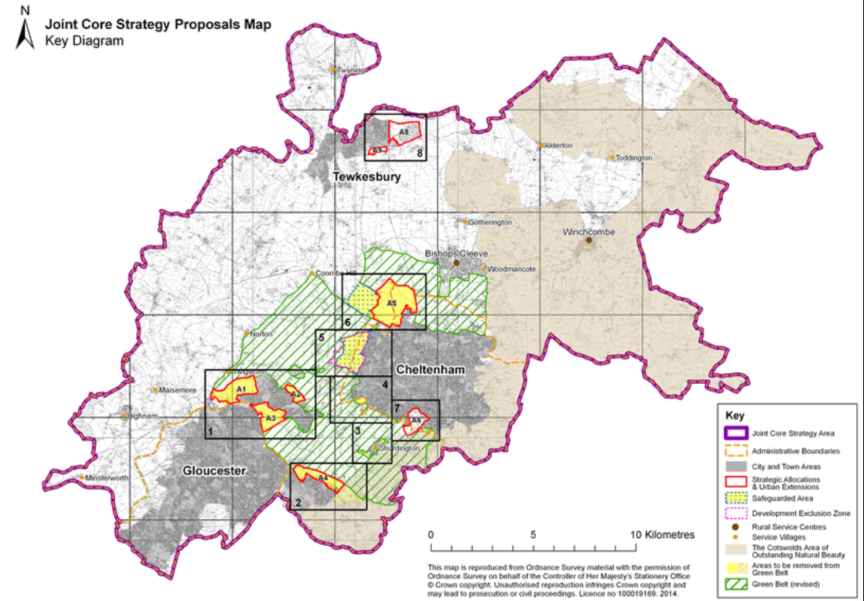
JOINT CORE STRATEGY AREA
GLOUCESTER, CHELTENHAM and TEWKESBURY

Slide 4
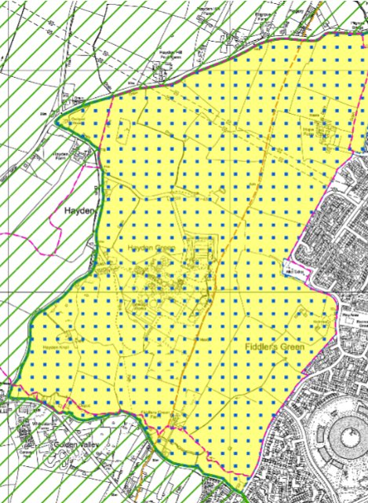
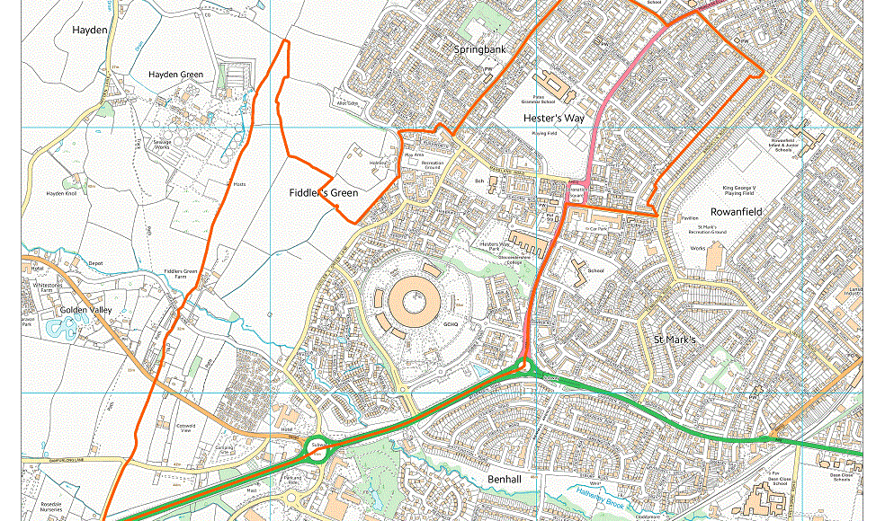
West Cheltenham Development Area
Hesters Way Neighbourhood Forum Area / Ward

Slide 5
Who can make Neighbourhood plans?
Parish Council
Local Forum
Involve as many residents, local workers and local businesses in the process as possible.
Attract wide support for the plan across the area, taking in a range of views.
Campaign to have the plan adopted by relevant bodies and by referendum.

Slide 6
What can a neighbourhood plan achieve?
Vision for future development
Social / Economic
Health / Educational
Environment / Climate change
Sites for business, homes and community facilities
Transport and parking
Protect buildings/areas of note /green spaces
Community safety

Slide 7
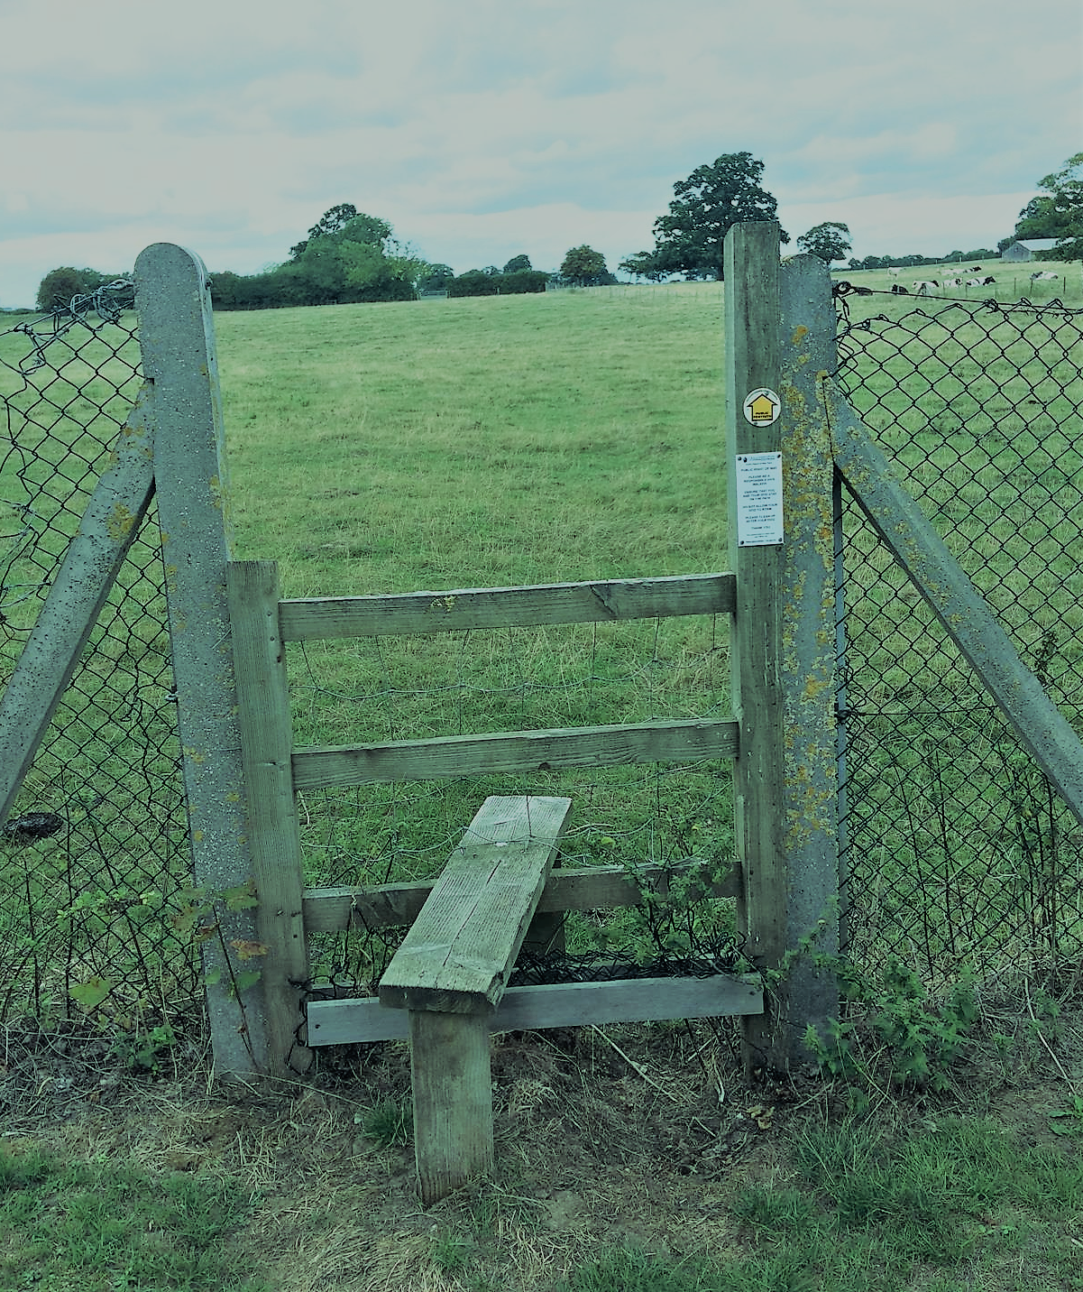
Cyber hub
context map

Slide 8
Landscape Vision
The following landscape principles have been developed and implemented as part of the masterplan:
Retaining Key Features
A New Community Hub
Park Edge + Connectivity

Slide 9
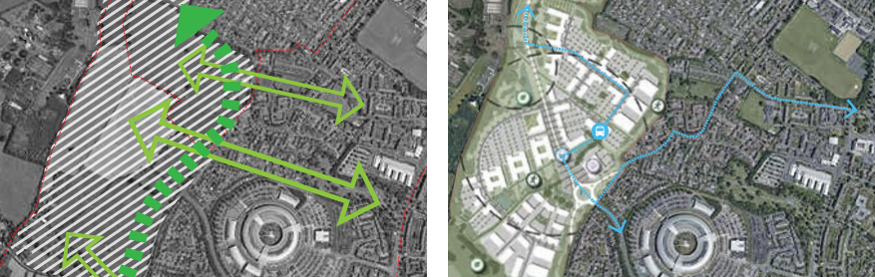
Landscape Vision
The following landscape principles have been developed and implemented as part of the masterplan:
‘GREEN’ Routes
Public Transport

Slide 10
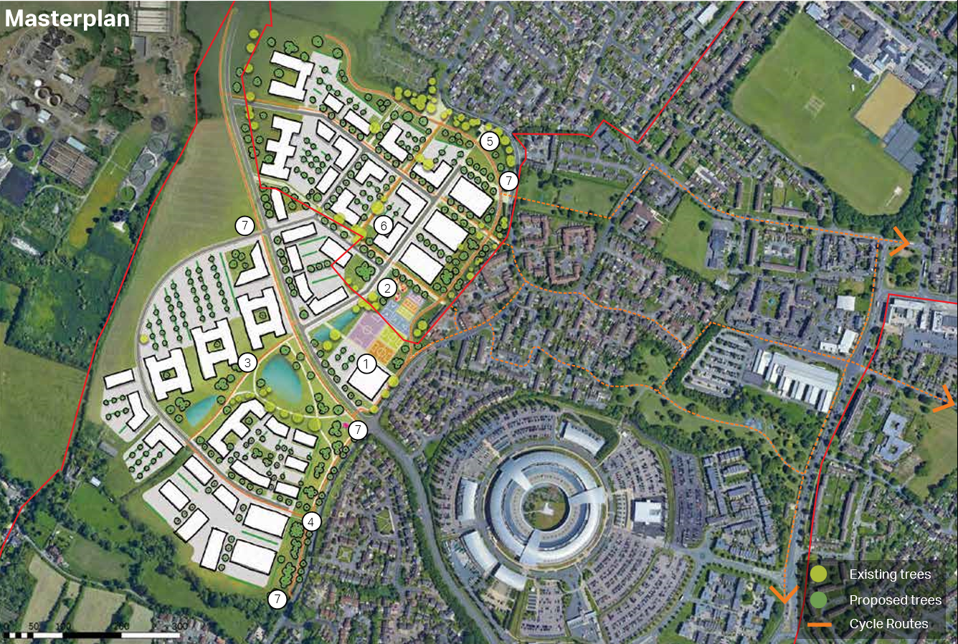
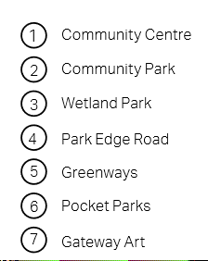

Slide 11
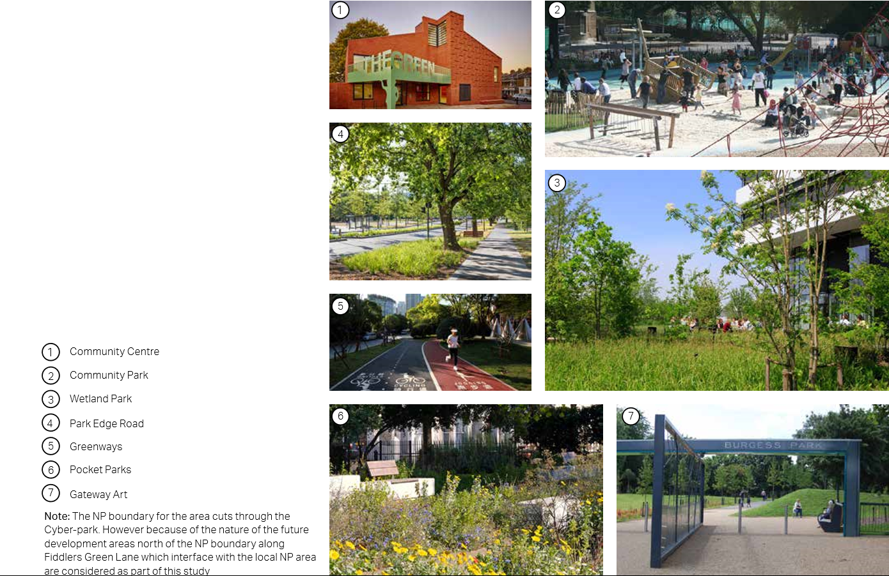

Slide 12
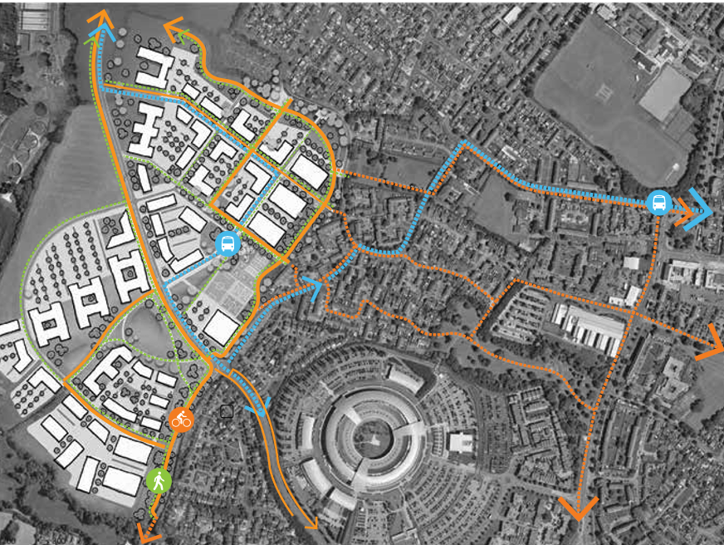
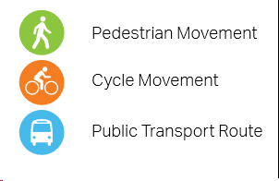
Getting Around
Movement networks encourage use of sustainable forms of movement including walking, cycling and public transport use.

Slide 13
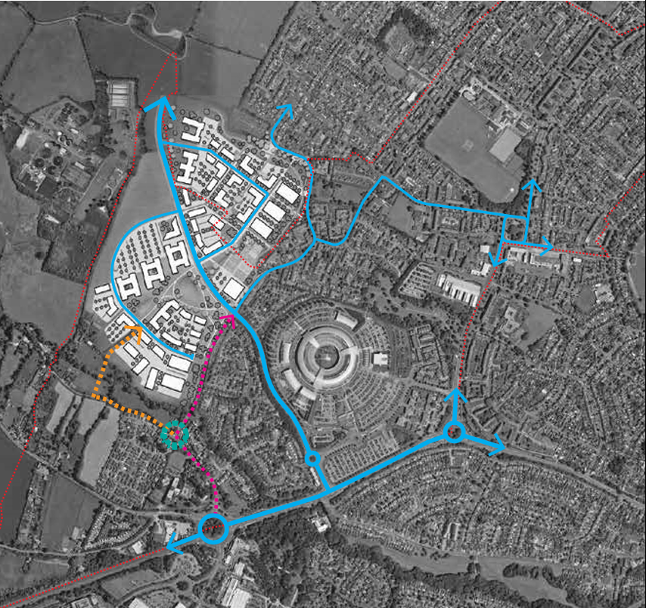
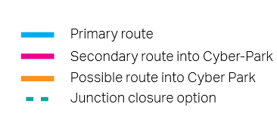
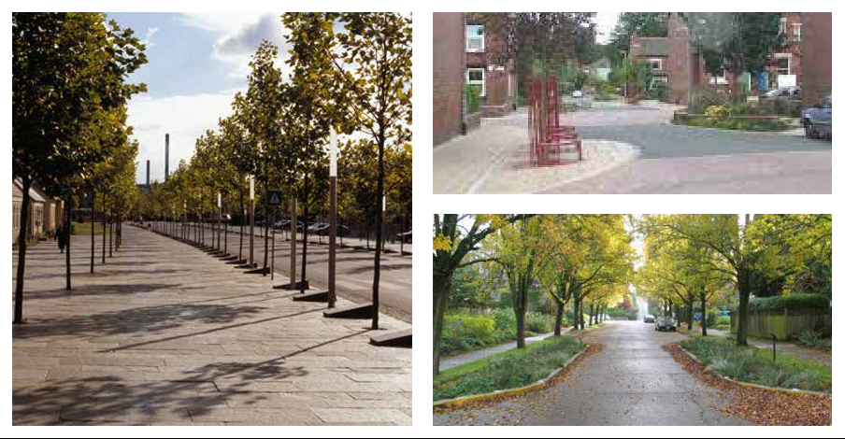
Transport Routes
A40 improvements
Junction 10 M5
Street parking
Traffic calming

Slide 14
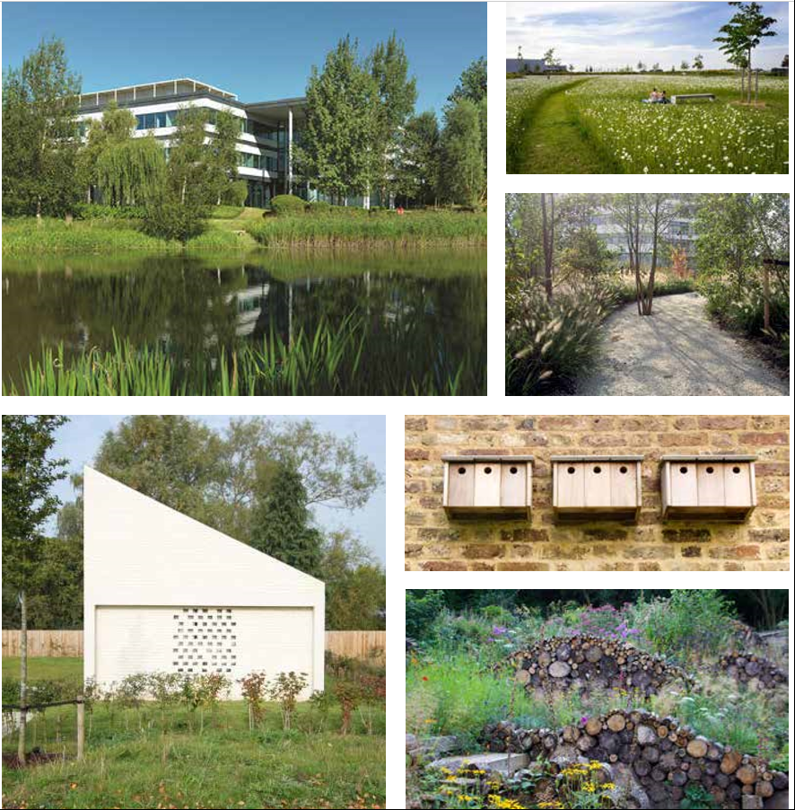
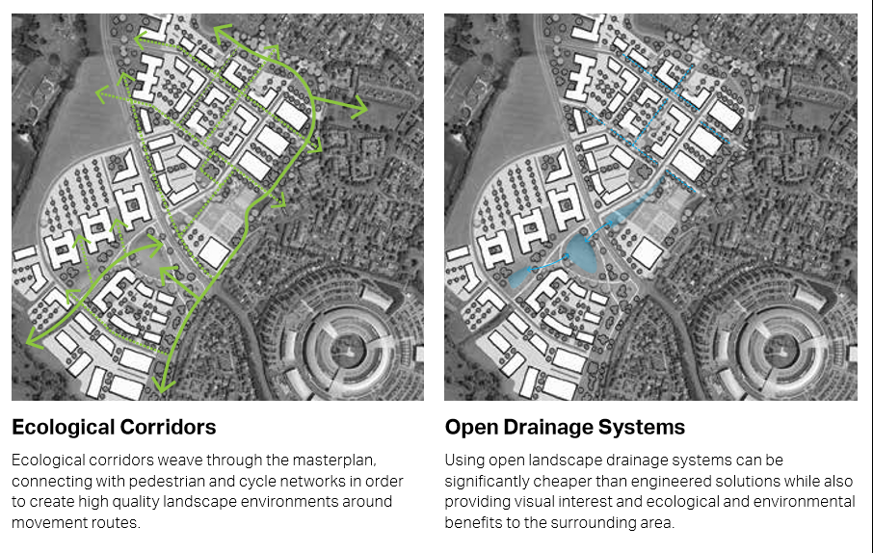
Biodiversity, Ecology and Drainage

Slide 15
